Slide 1


Route Optimization for Field Agent’s Journey Plan in Sales and Distribution
By Techlogix

Slide 2
Project Advisors
Internal:
Dr. Kamran Lodhi
External:
Mr. Mehran Khizar

Slide 3
Group Members
M. Mujahid Iqbal 15-4105
Zain Jaffery 15-4125
Hafiz Nokhaiz Ali 15-4347
Muhammad Zubair 15-4034

Slide 4
Project Overview
Route Optimizer is an online automated solution for route optimization and route planning for a field agent’s journey plan in sales and distribution. Considering all possible factors such as weather conditions, road conditions, road blockage, peak hours, traffic situations etc that affect route planning, this system provides an optimized automated solution that facilitates all field agents and managers at real. This Route plan should be optimized in a way that minimum transit time is achieved using the best possible route.
Notes:
Currently, a field agent is assigned a set of customers to visit daily. The sequence of visiting customers should be performed by Route Optimizer instead of KPO/Manager manually enlisting and sequencing the customers per Field Agent. This Route plan should be optimized in a way that minimum transit time is achieved using the best possible route

Slide 5
The Problem
Suppose 20 locations
We want to minimize total time
Total possible routes will be “2432902008176640000”
This is impractical for present computing
Notes:
Currently, a field agent is assigned a set of customers to visit daily. The sequence of visiting customers should be performed by Route Optimizer instead of KPO/Manager manually enlisting and sequencing the customers per Field Agent. This Route plan should be optimized in a way that minimum transit time is achieved using the best possible route

Slide 6
The Solution
Genetic Algorithm
Gives close to optimum solution
Computing done in real-time
Notes:
Currently, a field agent is assigned a set of customers to visit daily. The sequence of visiting customers should be performed by Route Optimizer instead of KPO/Manager manually enlisting and sequencing the customers per Field Agent. This Route plan should be optimized in a way that minimum transit time is achieved using the best possible route

Slide 7
Genetic Algorithm
(Our decided algorithm for route optimization)

Slide 8
Genetic Algorithm Parameters
Mutation Rate
Crossover Rate
Population Size
Number of generations

Slide 9
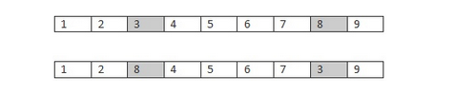
Structure of Chromosome, Mutation & Initial Population
Chromosome consist of all nodes (no repetition)
Swap Mutation Used
Initial population randomly created

Slide 10
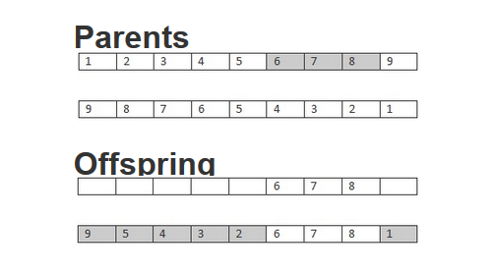
Crossover Method
Ordered Crossover

Slide 11
Fitness Function
Select first and second gene(location)
Find time between them through Google Distance Matrix API
Iterate through whole chromosome
Return total summed up time

Slide 12
Research Results
Number of locations | Global Maximum | G. A result | Brute Force (Global minimum)
4 | 22 min | 16.75 | 15.7
3 | 18 | 18 | 17
5 | 70 | 58 | 51
6 | 37 | 34 | 32
7 | 75 | 54 | 50
8 | 78 | 70 | 64
9 | 92 | 86 | 81
9 | 63 | 50 | 47
10 | 61 | 51 | 46
15 | 81 | 76 | Not possible
20 | 95 | 86 | Not possible

Slide 13
Locattions | Genetic Algorithm | Brute Force
4 | Real Time | Real Time
5 | Real Time | Real Time
8 | Real Time | 2 Seconds
9 | Real Time | 2 Seconds
10 | Real Time | 6 Seconds
12 | Real Time | 8 Minutes
15 | Real Time | 15 Days

Slide 14
Example
4 random locations
Transit times for all possible routes
4!=24 possible routes
Comparison with our implemented GA

Slide 15
results

Slide 16
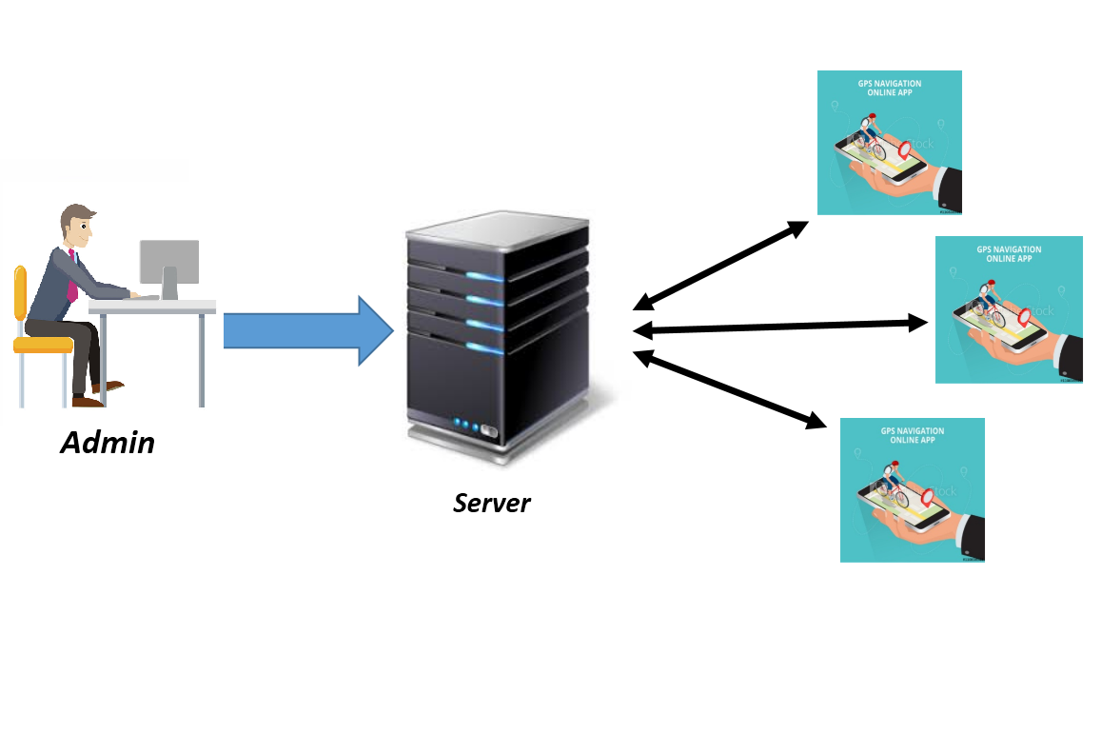
System’s Working

Slide 17
Achieved goals
Optimal path for each agent.
Reduced work of manager
Dynamic rerouting
Notifications for managers
Android Application for Agents

Slide 18
Demo: (Admin Portal)

Slide 19
Demo (Agent Portal)

Slide 20


